Slide 1

MACHINE LEARNING FOR
BREAST CANCER DIAGNOSIS
Artificial Intelligence Project
Shriya Raj Mahan
Vinamrata Sankhe

Slide 2
BREAST CANCER : An Overview
Breast cancer is among the most serious diseases in the world, causing many deaths in the current situation. Due to food and lifestyle changes, the number of cancer cases among women is increasing by the day.
This cancer is produced by abnormal growth of fatty and fibrous tissues, and the different phases of cancer are caused by cancer cells spreading throughout the tissue.
This is one of the most common cancers that affects women, but other types of cancer and those who are affected by them can be treated greatly, according to a government survey, when compared to breast cancer.
A women has about one in eight chance of being diagnosed with breast cancer in her lifetime, according to the National cancer Institute.
Men can also get breast cancer. In 2017, the American Cancer Society estimates 2,470 new cases of invasive breast cancer will be diagnosed in men in U.S.

Slide 3
PROBLEM STATEMENT
The cause of this disease is dependent on human factors and cannot be easily determined.
When many tests are involved in the detection of breast cancer, such as clump thickness, uniformity of cell size, uniformity of cell form, radius, area, smoothness, texture, perimeter and so on, the final result can be difficult to obtain, even for doctors.
This has resulted in an increase in the use of machine learning and computing in general as diagnostic tools in recent years.
The use of machine learning and data processing as diagnostic tools has become extremely effective, and one of the critical diseases in medicine where the classification task plays a critical role is the diagnosis of breast cancer.
Hence, the goal of this project is to significantly compare different classification learning algorithms in predicting the possibility of a patient having breast cancer.

Slide 4
ABSTRACT
Breast cancer affects the majority of women worldwide, and it is the second most common cause of death among women.
However, if cancer is detected early and treated properly, it is possible to be cured of the condition. Early detection of breast cancer can dramatically improve the prognosis and chances of survival by allowing patients to receive timely clinical therapy.
Furthermore, precise benign tumour classification can help patients avoid unneeded treatment.
This project uses machine learning models, whose features are obtained from digitised image of breast mass, as to forecast and analyse cancer databases in order to improve accuracy.
The dataset will be analysed, evaluated, and model is trained as part of the process. Finally, both image and numerical test data will be used for prediction.

Slide 5
DATASET DESCRIPTION
Features are computed from a digitized image of a fine needle aspirate (FNA) of a breast mass. They describe characteristics of the cell nuclei present in the image.
The dataset has 569 rows and 27 columns.
Attribute Information:
ID number
Diagnosis (M = malignant, B = benign)
Ten real-valued features are computed for each cell nucleus:
radius (mean of distances from center to points on the perimeter)
texture (standard deviation of gray-scale values)
perimeter
Area
smoothness (local variation in radius lengths)
compactness (perimeter^2 / area - 1.0)
concavity (severity of concave portions of the contour)
concave points (number of concave portions of the contour)
symmetry
fractal dimension ("coastline approximation" - 1)

Slide 6
TECHNOLOGIES USED
Jupyter notebook for Implementation
Anaconda environment
Language of implementation: Python
Inbuilt python Libraries for data pre-processing
Machine learning models for obtaining the accuracy of prediction
Plotly and matplotlib to obtain visualization of the obtained results

Slide 7
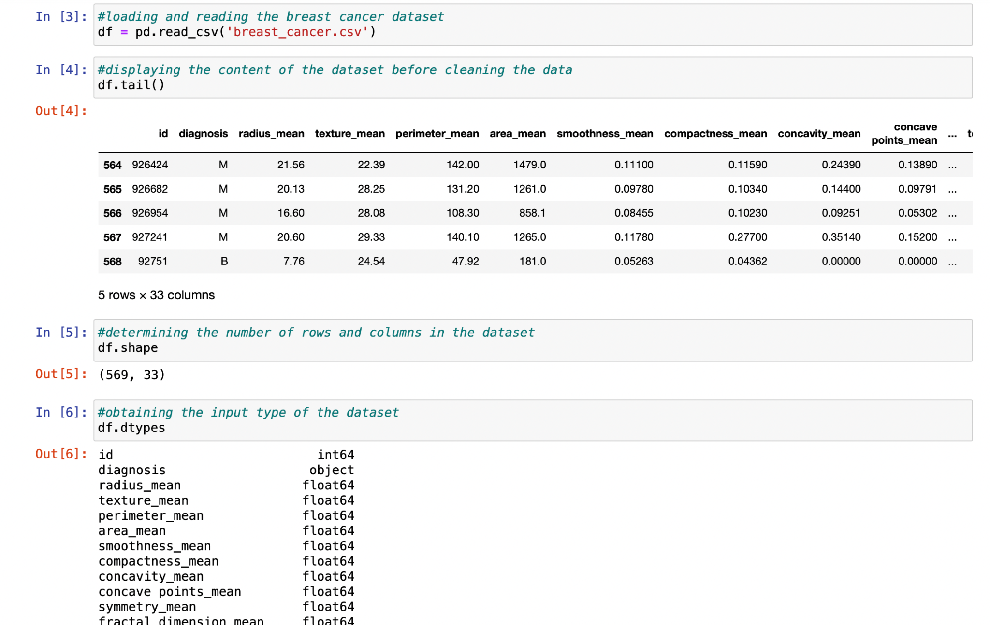
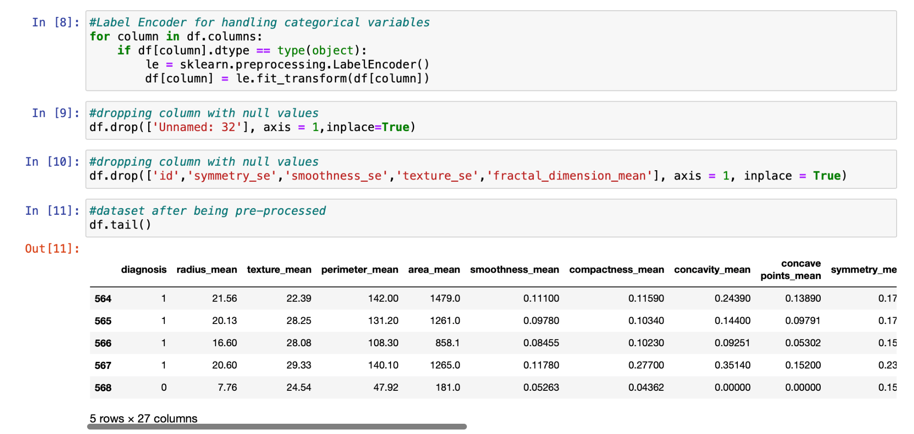
METHODOLOGY
Exploring the Data Set Data-Preprocessing & Cleaning

Slide 8
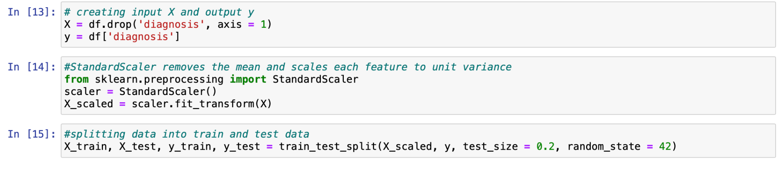
Breaking dataset into Input X and Output Y
Splitting X and Y in training and testing data: This phase extracts the features from the dataset, and the testing phase will deliver new data to be examined to see how well our algorithm works and behaves when it comes to prediction. The dataset is divided into two pieces. To avoid fitting, cross-validation is performed.

Slide 9
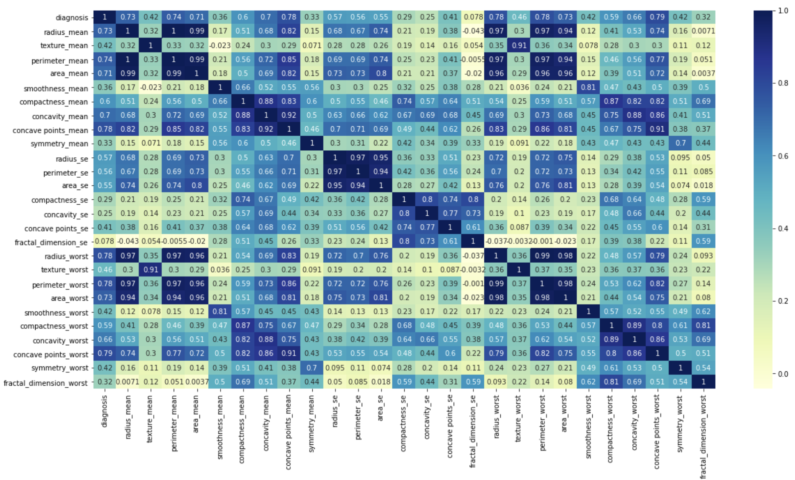
CORRELATION HEATMAP
finding the pairwise correlation of all columns in the dataframe

Slide 10
ALGORITHMS USED
Logistic Regression: Logistic regression is supervised learning classification algorithm used to predict the probability of a target variable. The nature of target or dependent variable is dichotomous, which means there would be only two possible classes.
Random Forest Classifier: Random forest classifier creates a set of decision trees from randomly selected subset of training set. It then aggregates the votes from different decision trees to decide the final class of the test object.

Slide 11
ALGORITHMS USED
K neighbors Classifier: The k-nearest neighbors (KNN) algorithm is a simple, supervised machine learning algorithm that can be used to solve both classification and regression problems. It's easy to implement and understand, but has a major drawback of becoming significantly slows as the size of that data in use grows.
Decision Tree Classifier: Decision tree classifiers are used successfully in many diverse areas. It is the classification techniques used machine learning where the data is continuously split according to a certain parameter.

Slide 12
ALGORITHMS USED
Ada Boosting: An AdaBoost classifier is a meta-estimator that begins by fitting a classifier on the original dataset and then fits additional copies of the classifier on the same dataset but where the weights of incorrectly classified instances are adjusted such that subsequent classifiers focus more on difficult cases.
Bagging: A Bagging classifier is an ensemble meta-estimator that fits base classifiers each on random subsets of the original dataset and then aggregate their individual predictions (either by voting or by averaging) to form a final prediction. Such a meta-estimator can typically be used as a way to reduce the variance of a black-box estimator (e.g., a decision tree), by introducing randomization into its construction procedure and then making an ensemble out of it.

Slide 13
ALGORITHMS USED
Gradient Boosting: Gradient boosting is a technique attracting attention for its prediction speed and accuracy, especially with large and complex data.It relies on the intuition that the best possible next model, when combined with previous models, minimizes the overall prediction error. The key idea is to set the target outcomes for this next model in order to minimize the error.
Support Vector Machines: SVM is a set of supervised learning method used for classification, regression and outliers detection. The advantages of support vector machines are: Effective in high dimensional spaces. Still effective in cases where number of dimensions is greater than the number of samples.

Slide 14
ALGORITHMS USED
Ensemble Learning: Ensemble learning is a general meta approach to machine learning that seeks better predictive performance by combining the predictions from multiple models. The three main classes of ensemble learning methods are bagging, stacking, and boosting.
Bagging involves fitting many decision trees on different samples of the same dataset and averaging the predictions.
Stacking involves fitting many different models types on the same data and using another model to learn how to best combine the predictions.
Boosting involves adding ensemble members sequentially that correct the predictions made by prior models and outputs a weighted average of the predictions.

Slide 15
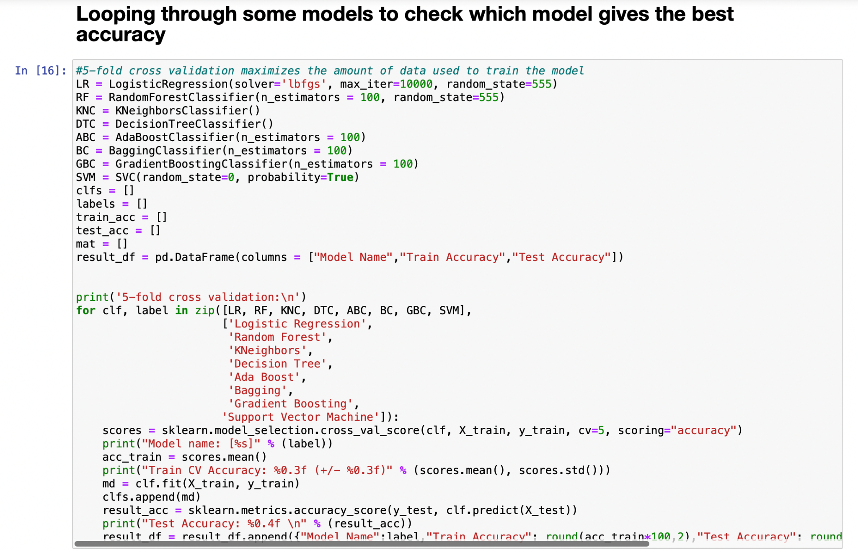
5-FOLD CROSS VALIDATION
It maximizes the amount of data that is used to train the model.

Slide 16
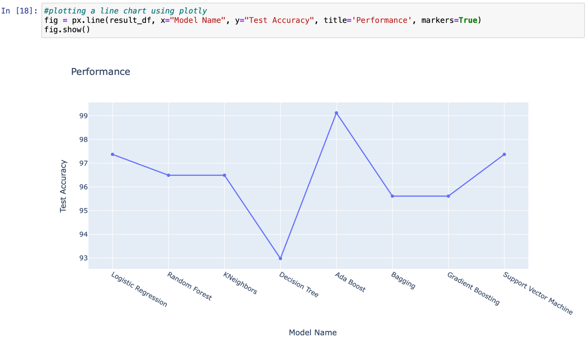
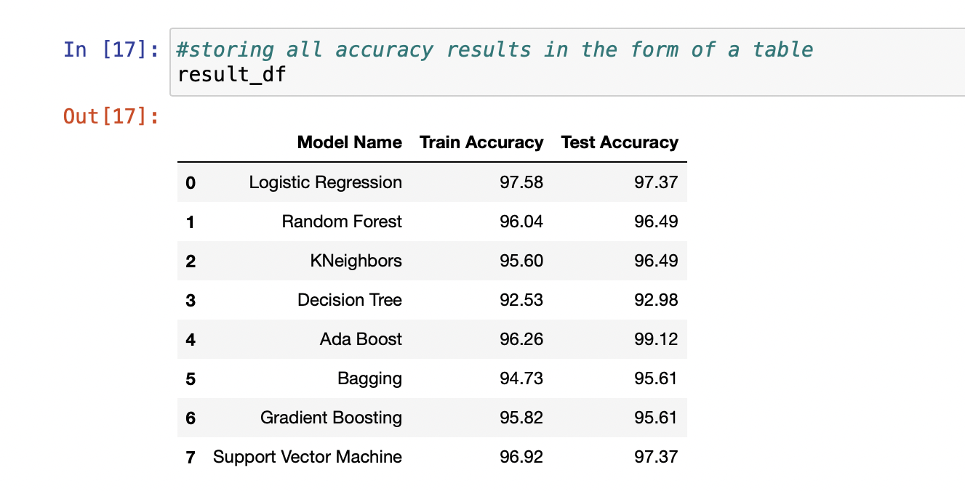
RESULTS
Accuracy comparison

Slide 17
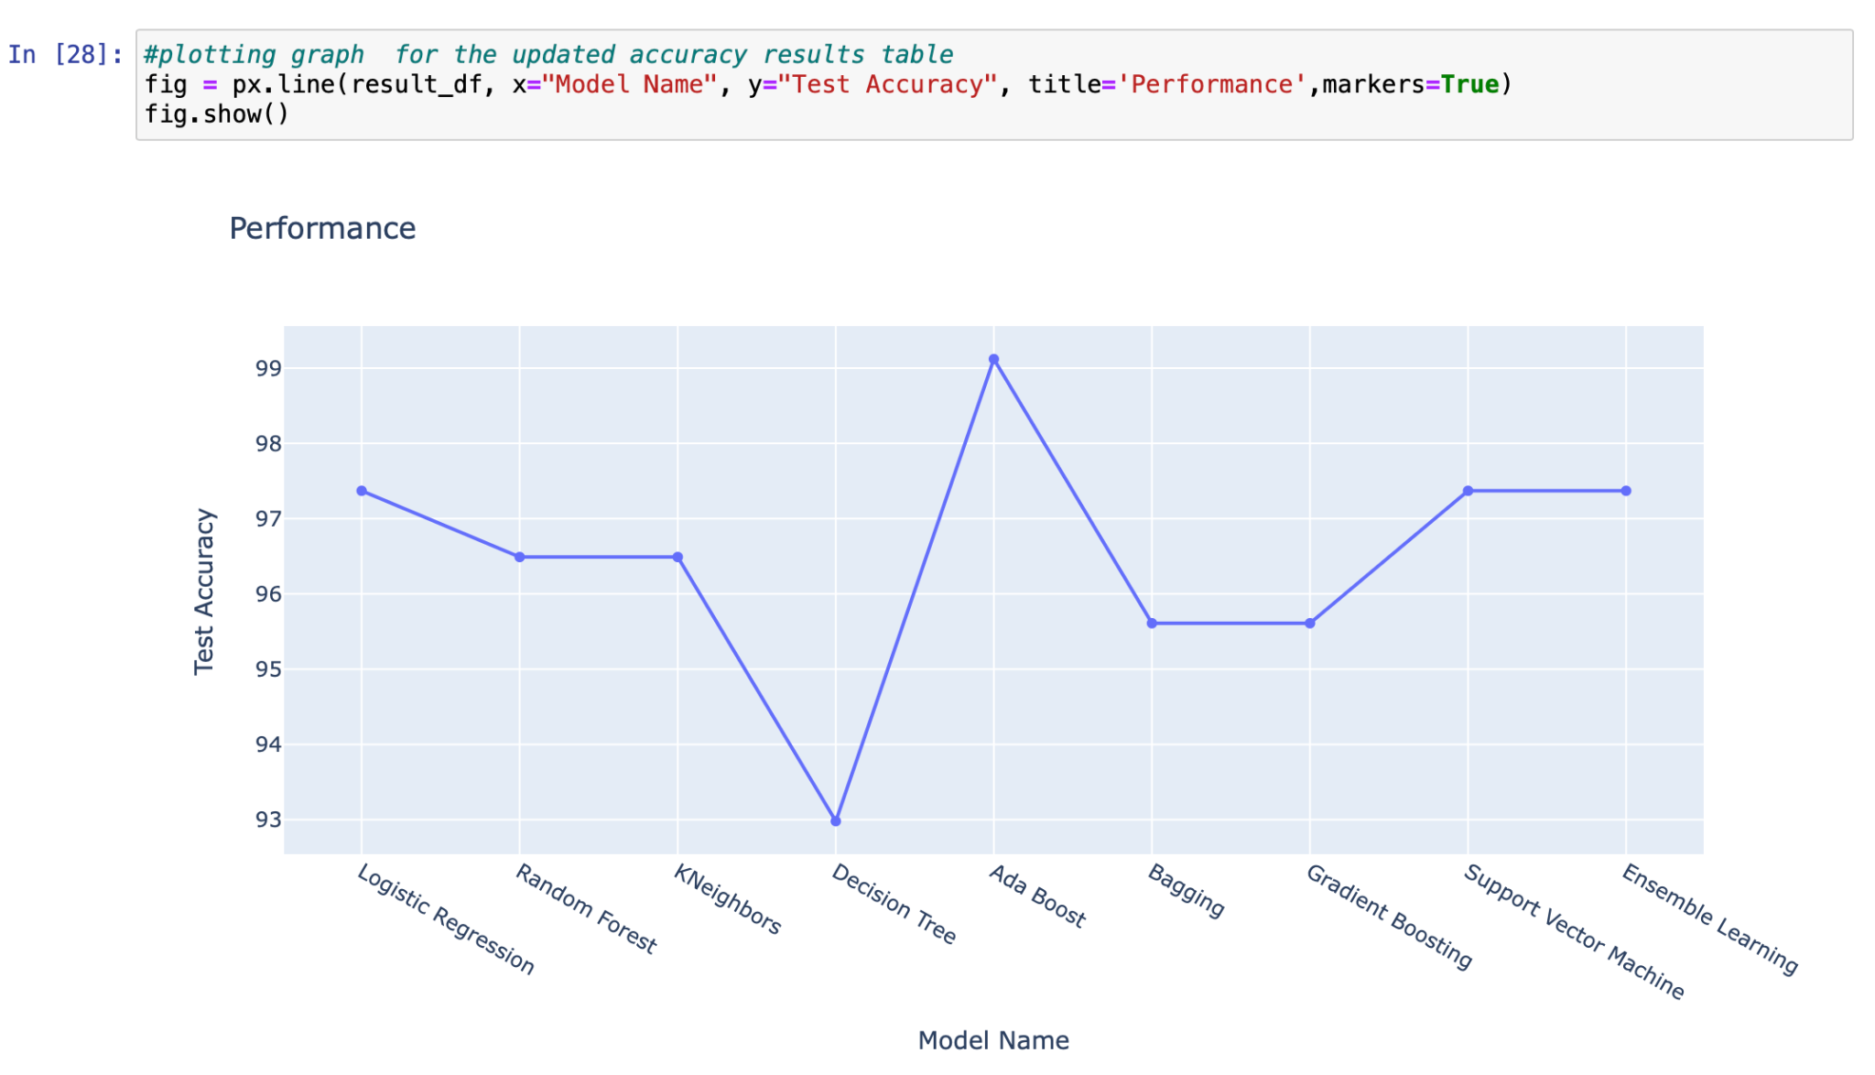
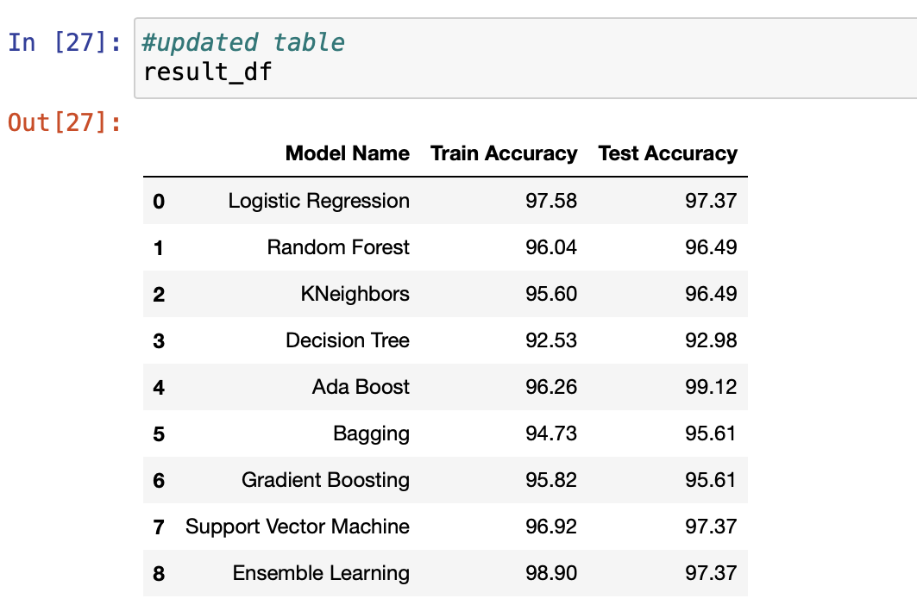
RESULTS
Accuracy after ensemble learning

Slide 18
CONCLUSION
After observing the obtained results, we can conclude that the Ada Boosting Classifier gives us the highest accuracy of prediction of 99.12%
Though we use ensemble method, it tends to give us as accuracy of 97.37% which is similar to the accuracy obtained by using the Logistic Regression model, but comparatively better than the other models that are being used to determine which model is the most efficient to predict the diagnosis of Breast Cancer.
Hence, the obtained results of the analysis.

Slide 19
REFERENCES
https://pubmed.ncbi.nlm.nih.gov/33498339/
https://www.kaggle.com/datasets/uciml/breast-cancer-wisconsin-data
https://towardsdatascience.com/building-a-simple-machine-learning-model-on-breast-cancer-data-eca4b3b99fa3

Slide 20
THANK YOU

